Slide 1
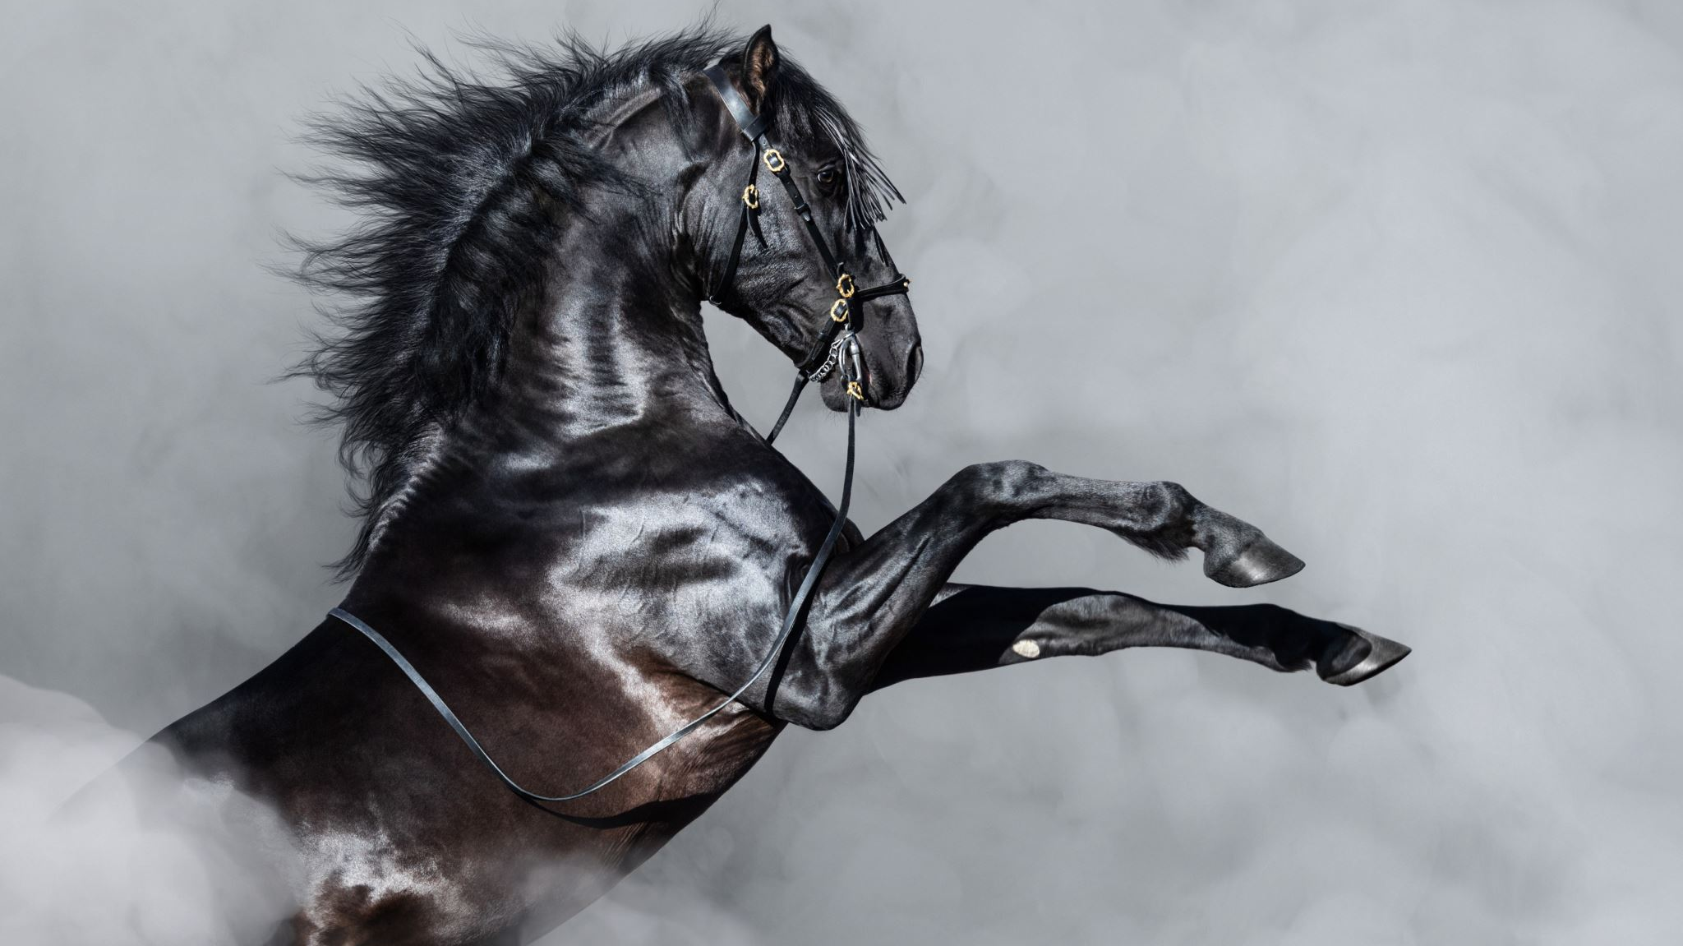
Define project outputs
By Elena Montalvo

Slide 2
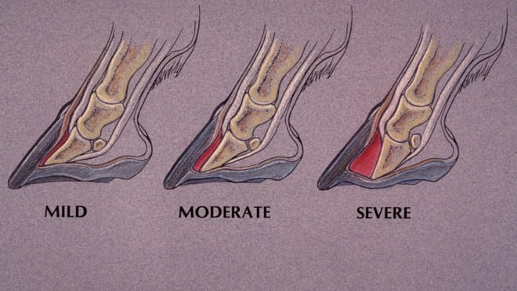
Laminitis Horse
Laminitis is commonly divided into three phases: mild, moderate, and severe. The hoof of a horse with laminitis showing displacement of the coffin bone.

Slide 3
Signs of acute laminitis:
Shifting lameness when standing and lameness when the horse is turned in a circle
Heat in the foot and increased digital pulses (palpable on either side of the sesamoid bones at the level of the fetlock)
Pain in the toe region when pressure is applied
Reluctance to walk and a very stiff/hesitant gait
A "sawhorse" stance in which the horse will rock back on its haunches and place its front feet stretched out in front of them to alleviate pressure on the toes

Slide 4
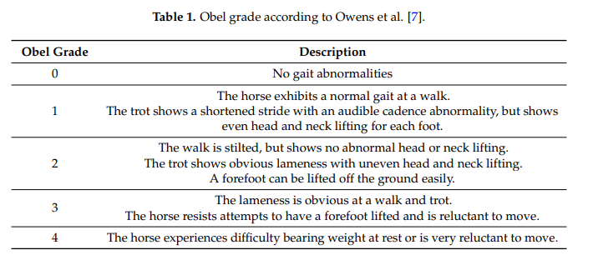
Horse with laminitis
The Obel grading system is a simple descriptive scale developed to evaluate equine lameness; it is the most widely accepted method for describing the severity of laminitis by equine practitioners . The clinical assessment of the Obel grade includes the observation of the horse walking and trotting in a straight line on a hard surface, away from and towards the assessor.

Slide 5
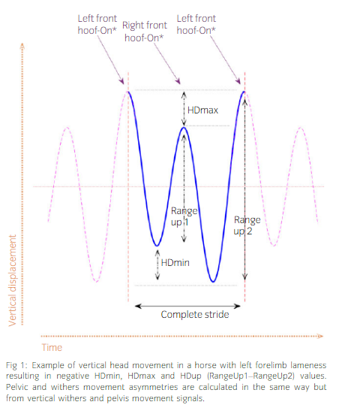
Lameness horse
Lameness can be described as an abnormal walk, usually noted by an asymmetry in movement.
significant difference, the limb exhibiting the lower ground reactive force

Slide 6
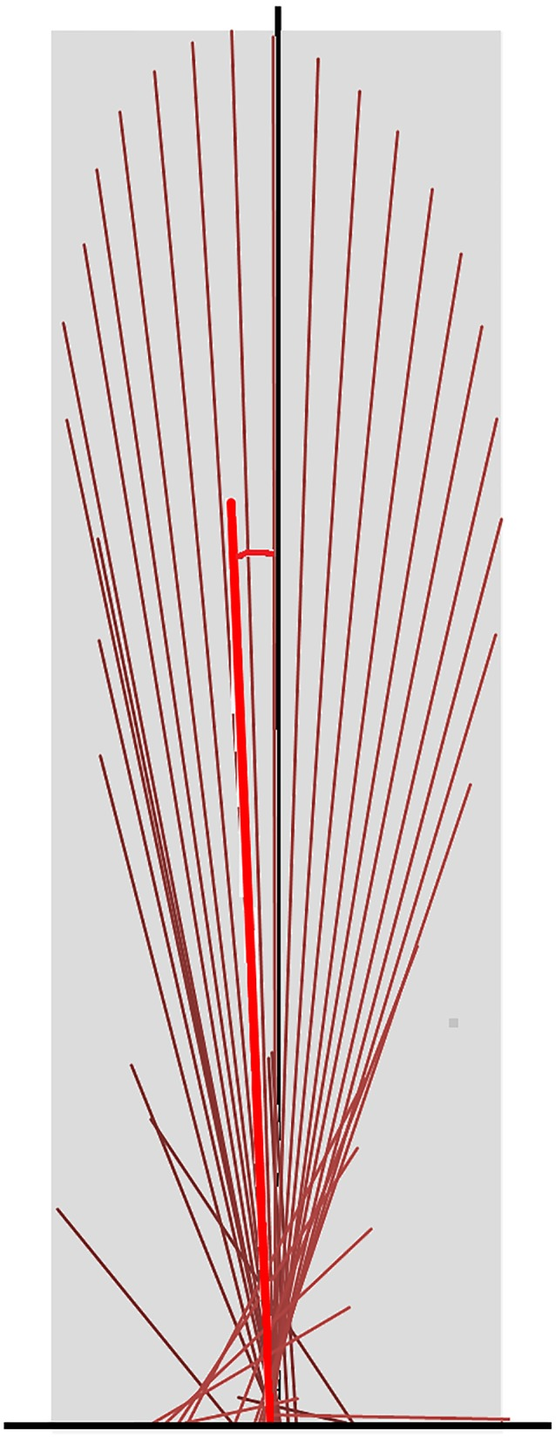
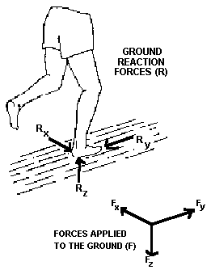
Low Ground Reactive force

Slide 7
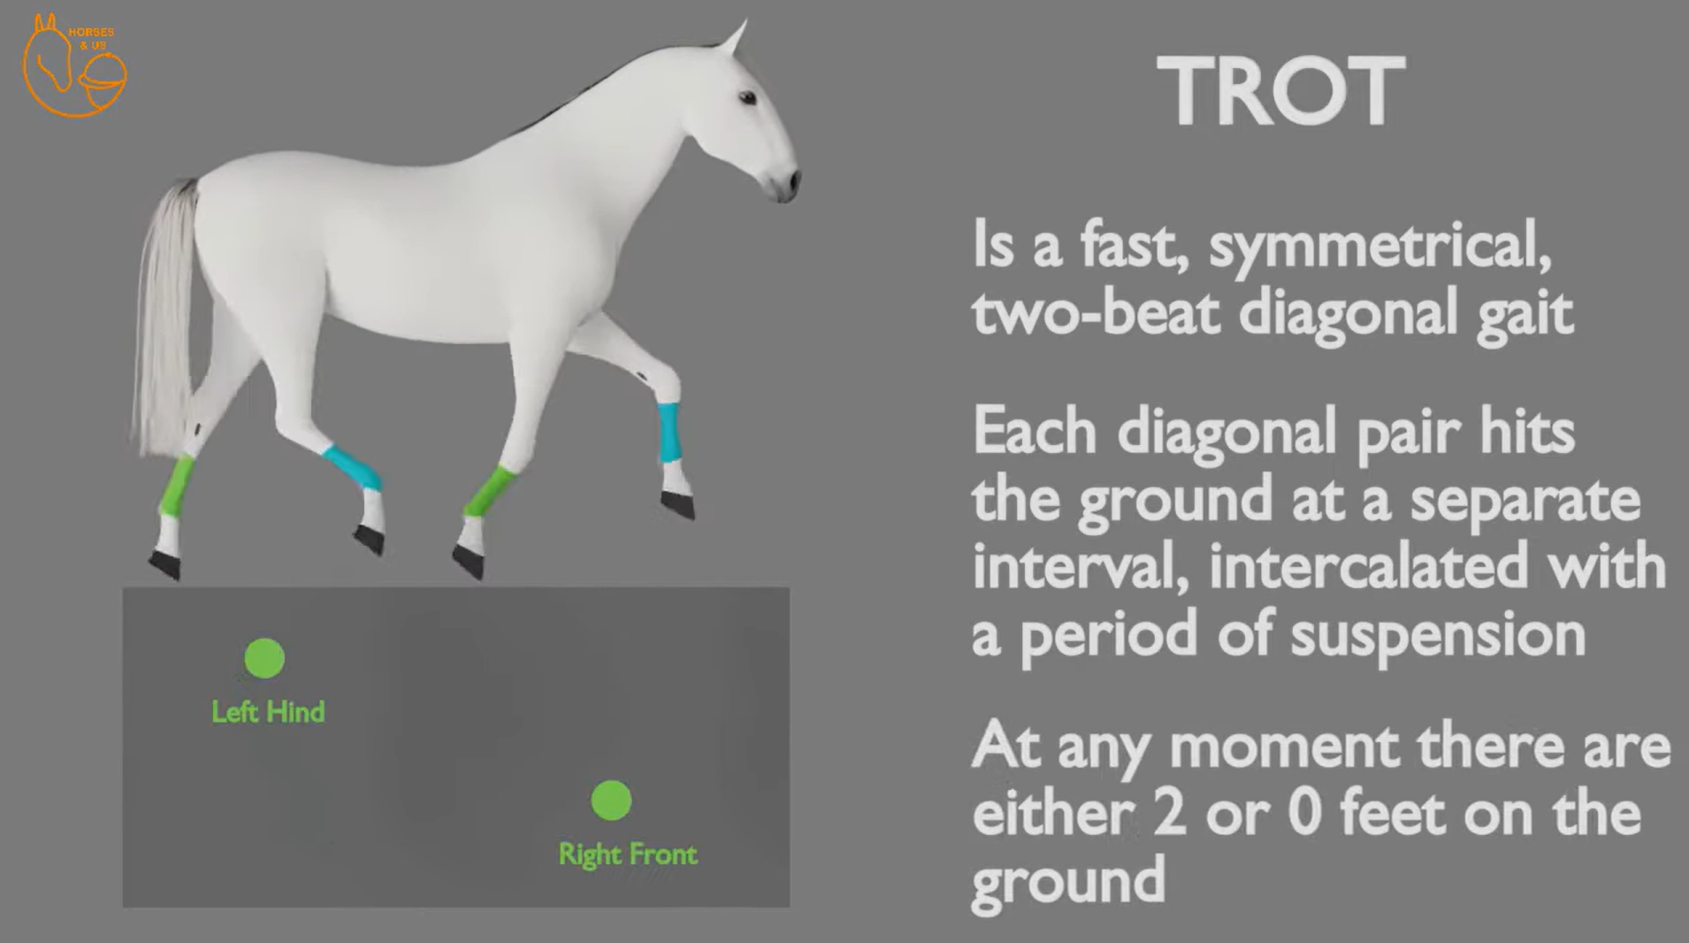
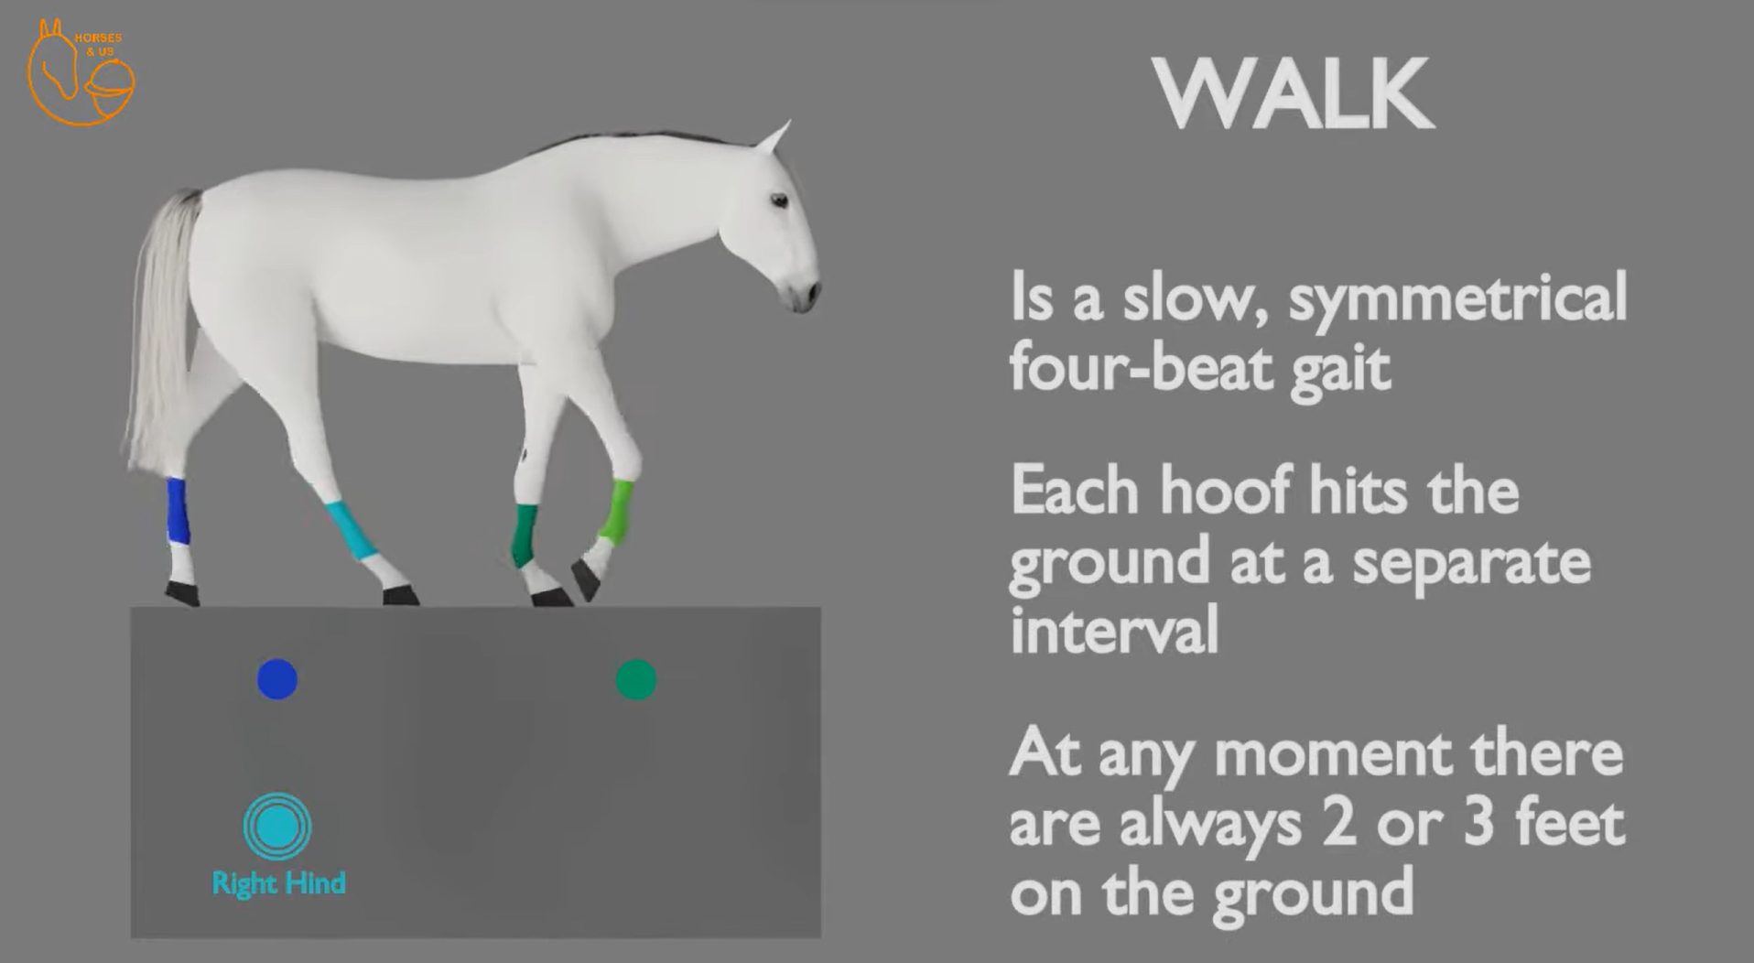
Horse Gait

Slide 8
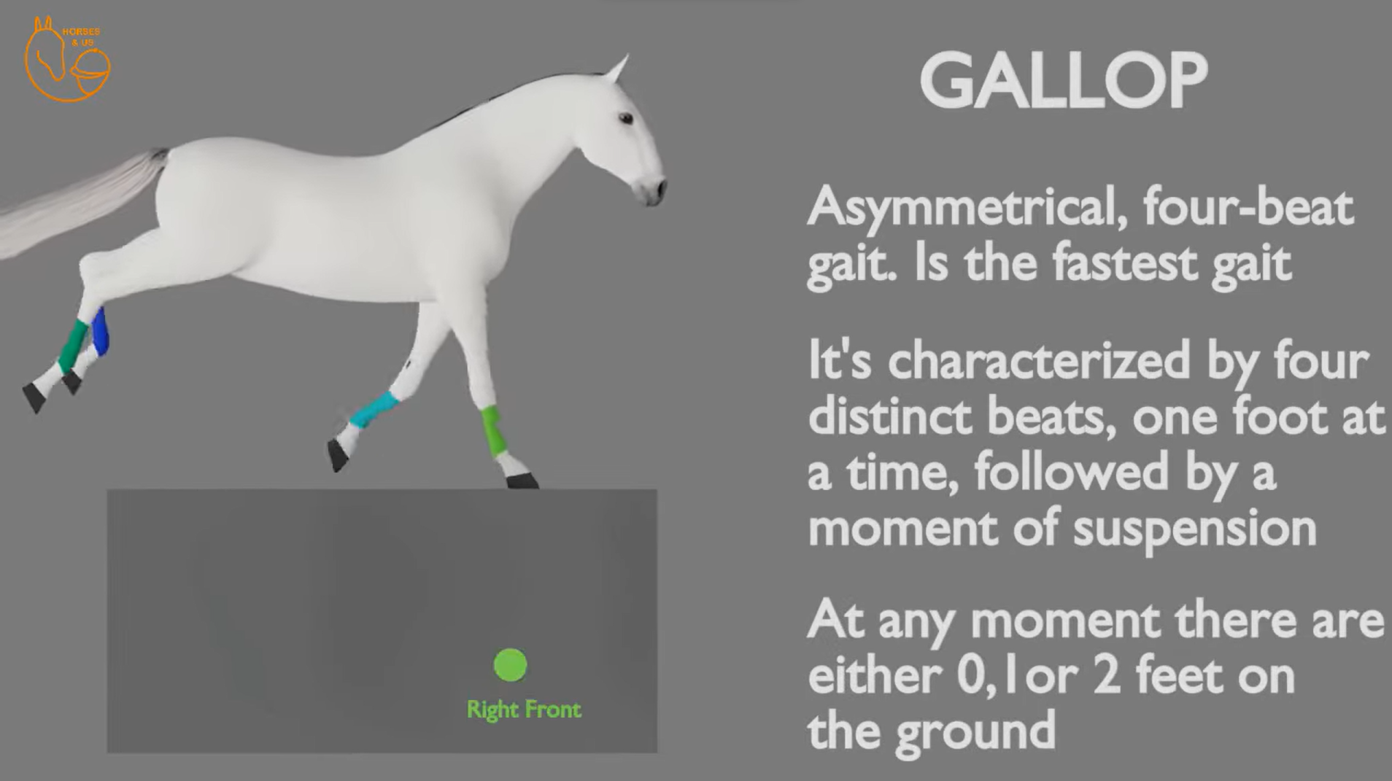

Slide 9
(F) and the anteroposterior (F_{X}), vertical (F_{Y}) and mediolateral (F_{Z}) components of the ground reaction force at one point in the single-support phase of the right leg. (When walking straight forward, the mediolateral component is normally very small resulting in little side-to-side movement of the body)

Slide 10
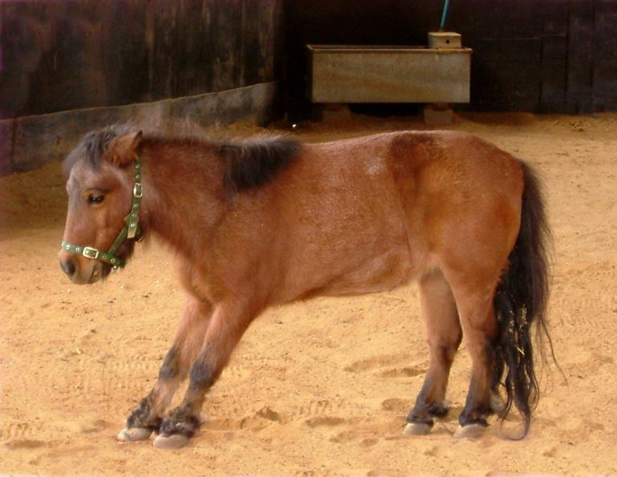
“Sawhorse” Stands
The weight is shift to the heel

Slide 11
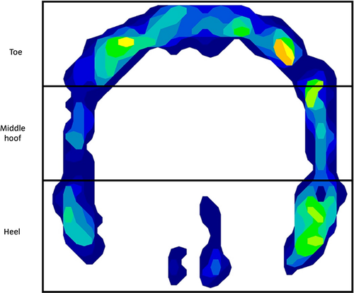
“Sawhorse” Stands
Force Plate
(F) and the anteroposterior (F_{X}), vertical (F_{Y}) and mediolateral (F_{Z}) components of the ground reaction force at one point in the single-support phase of the right leg. (When walking straight forward, the mediolateral component is normally very small resulting in little side-to-side movement of the body)

Slide 12
Human Motion
Lamemess and Gait

Slide 13
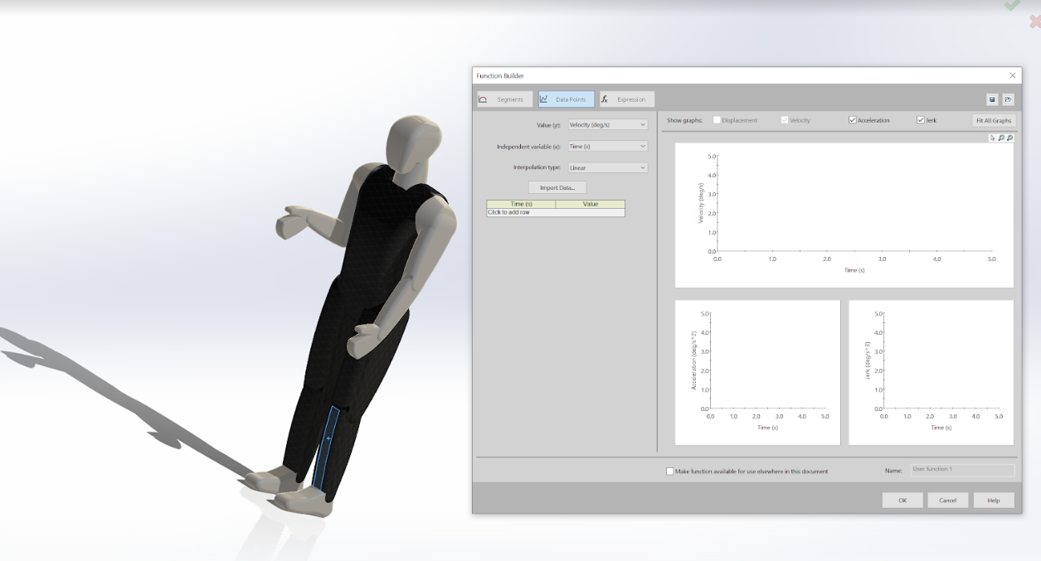
Visual Recitation

Slide 14
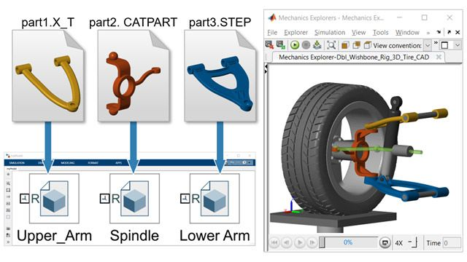
Simulink (Multibody)

Slide 15
Resources
https://csu-cpp.primo.exlibrisgroup.com/discovery/fulldisplay?docid=cdi_proquest_miscellaneous_2150532570&context=PC&vid=01CALS_PUP:01CALS_PUP&lang=en&search_scope=everything&adaptor=Primo%20Central&tab=Everything&query=any,contains,laminitis%20walk%20
https://www.sciencedirect.com/topics/immunology-and-microbiology/ground-reaction-force
https://news.okstate.edu/articles/communications/2021/taking-the-guesswork-out-of-equine-lameness-detection.html
https://www.ncbi.nlm.nih.gov/pmc/articles/PMC5827015/
https://www.ncbi.nlm.nih.gov/pmc/articles/PMC5827015/#ref-16

Slide 16
Similar Projects
https://equinosis.com/horse-owners/

